Slide 1

Walmart weekly sales forecasting (Kaggle competition)
Yekaterina Bardash
Regis University
Practicum II

Slide 2
Project Goals
Kaggle
Time Series
Programming
Motivations – learning new things, business applications, practicing real-world skills
SQL
MySQL Server
DataGrip
Predict 34 weeks of Walmart Stores sales for each store and department combination
~ 3300 combinations!

Slide 3
Data
train
features
stores
test
Store 1-45
Dept 1-99
Date 2/10 – 11/12
Weekly Sales $
IsHoliday Y/N
Store
Type (A/B)
Size
Store
Dept
Date
Weekly Sales
IsHoliday
Store
Date
Temperature
Fuel Price
MarkDown1 - 5
CPI
Unemployment
IsHoliday
421,571 rows
8191 rows
45 rows
115,065 rows

Slide 4
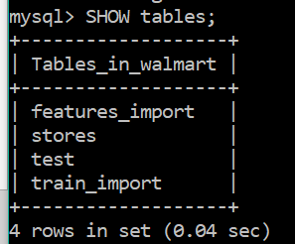
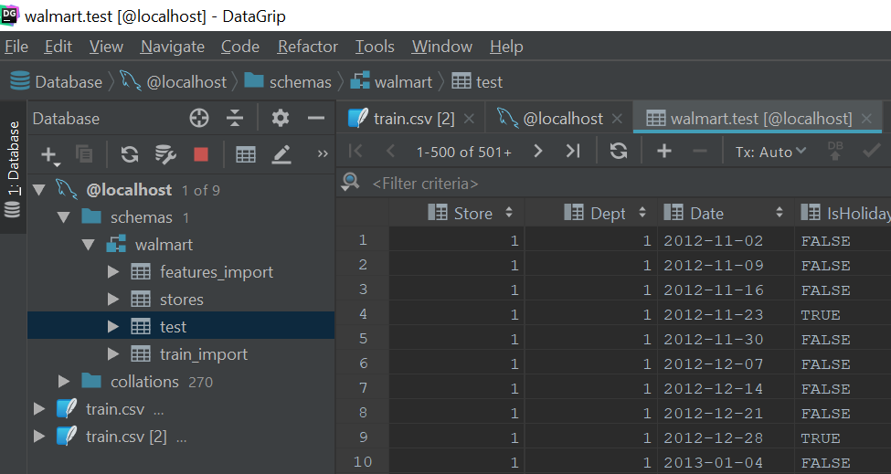
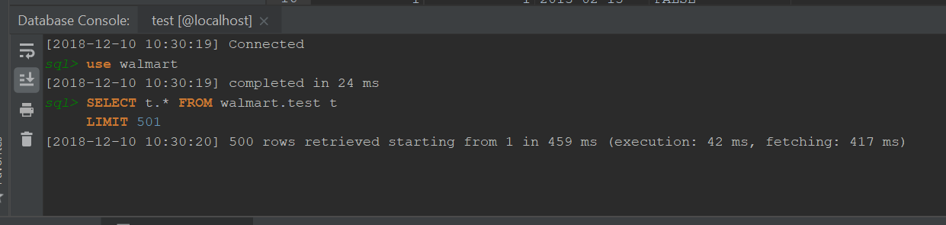
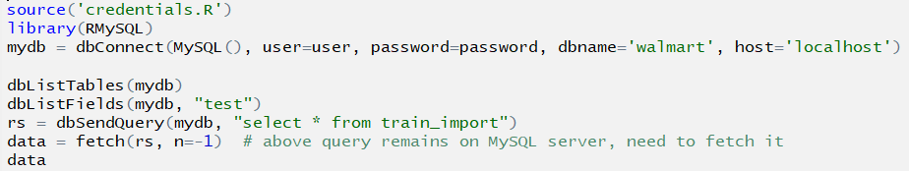
Goal 1: practice mysql, SQL, & DataGRIP

Slide 5
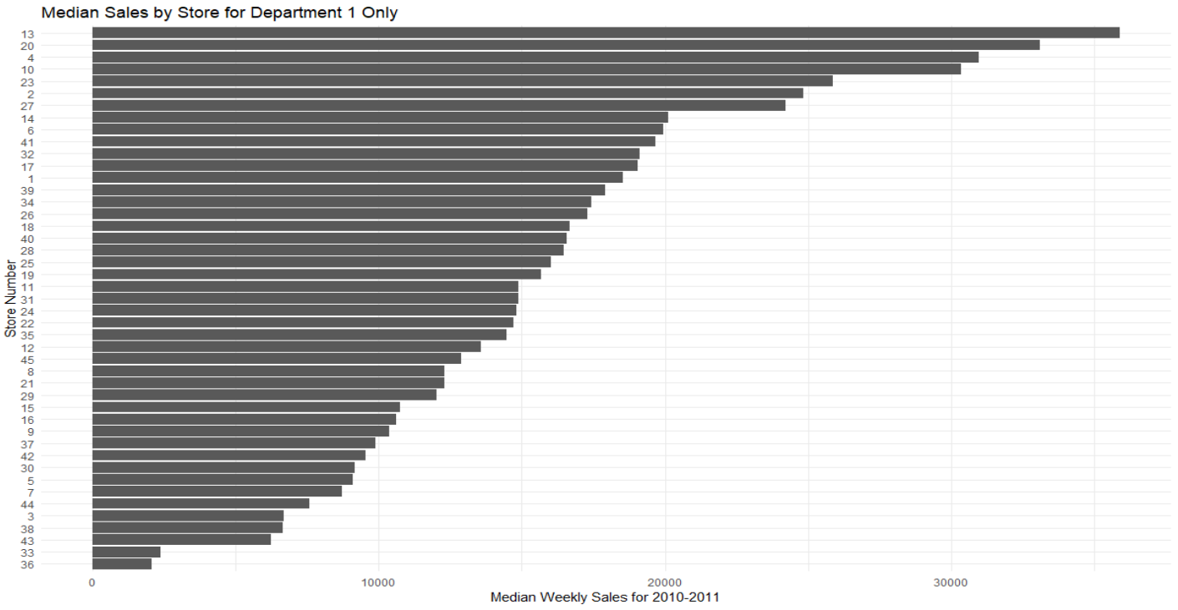
Goal 2: Time series - EDA
High
13
Medium
25
Low
36

Slide 6
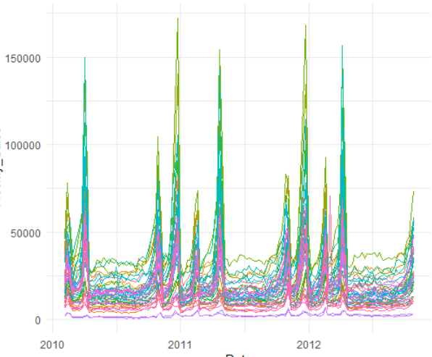
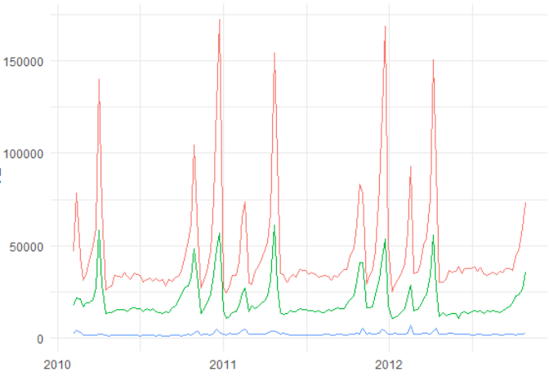

Weekly sales for Dept 1 :: 2010-2012
Walmart Weekly Sales per Store
Walmart Weekly Sales per High/Medium/Low Store
High
Medium
Low

Slide 7
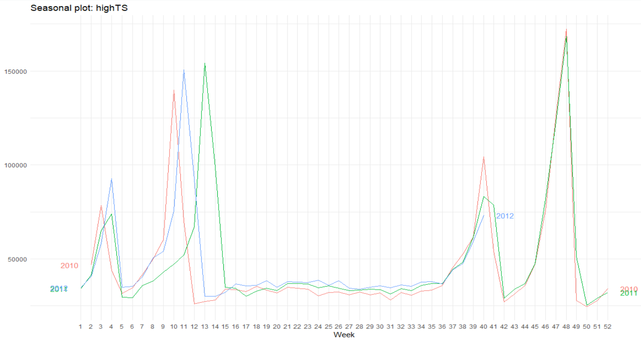
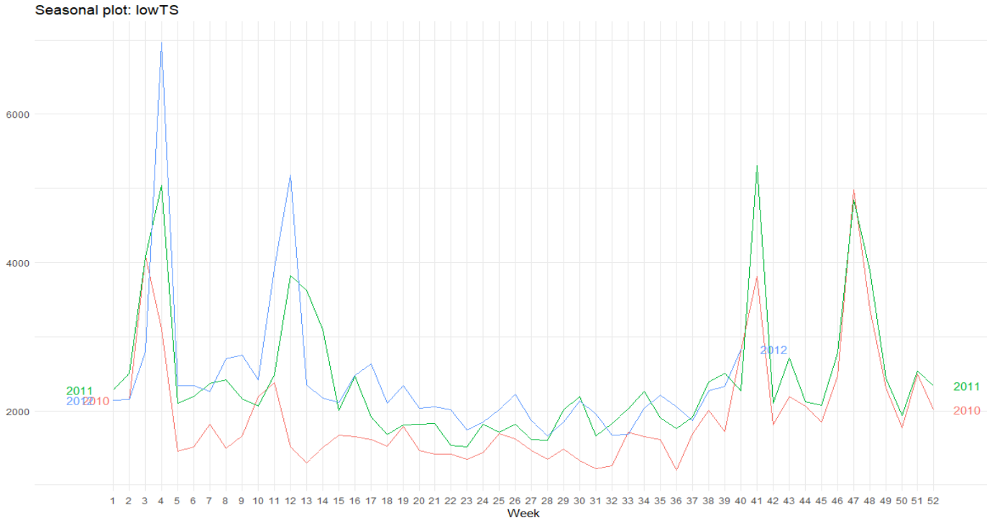
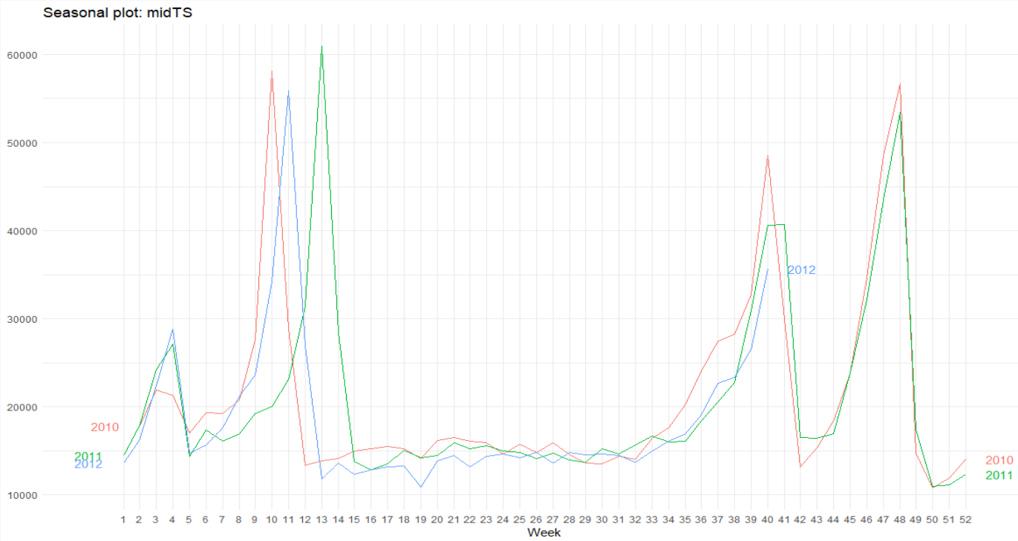
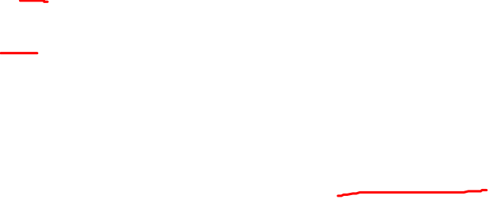
Goal 2: Time series - EDA
High
Medium
Low

Slide 8
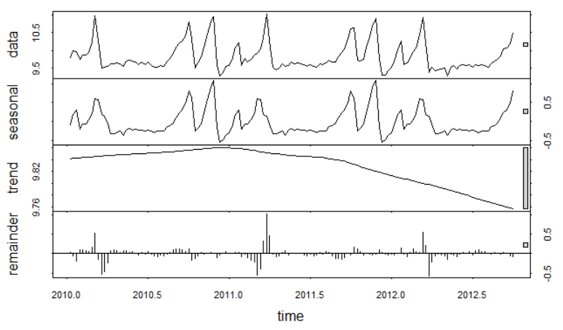
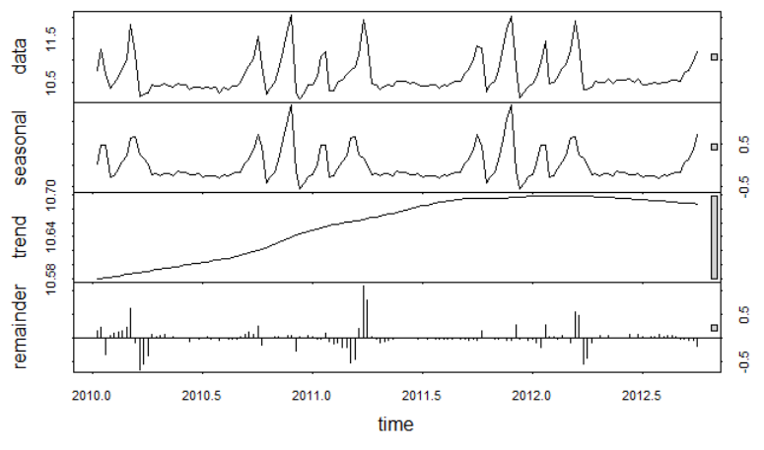
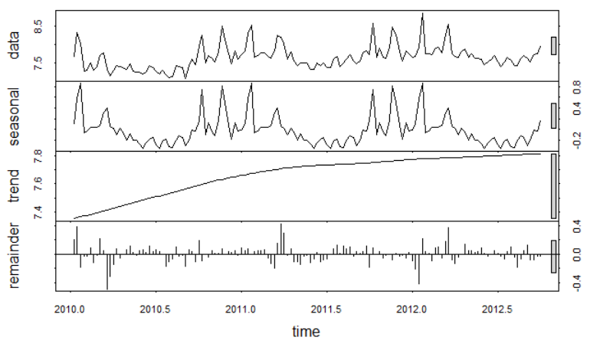
Decomposing Season, Trend, Remainder
High
Low
Medium

Slide 9
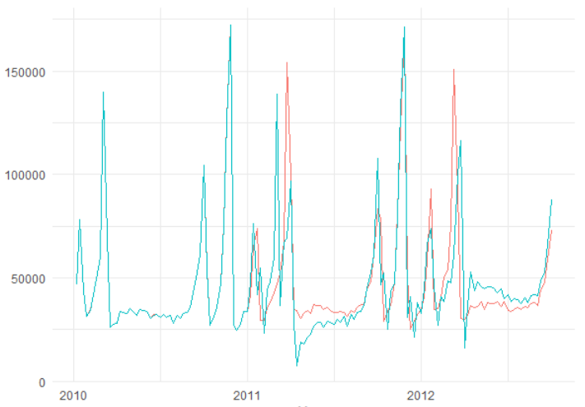
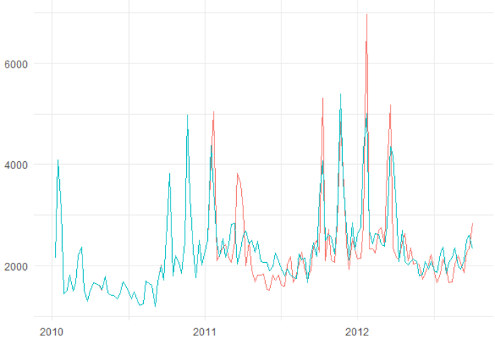
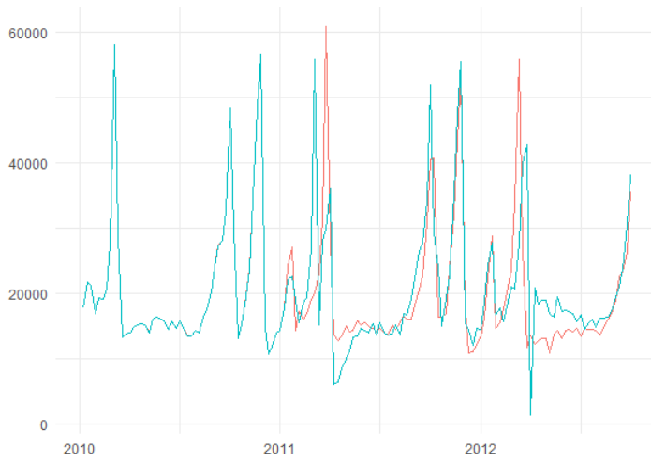

Evaluating model fit :: visually
Data
Fit
Medium
High
Low

Slide 10
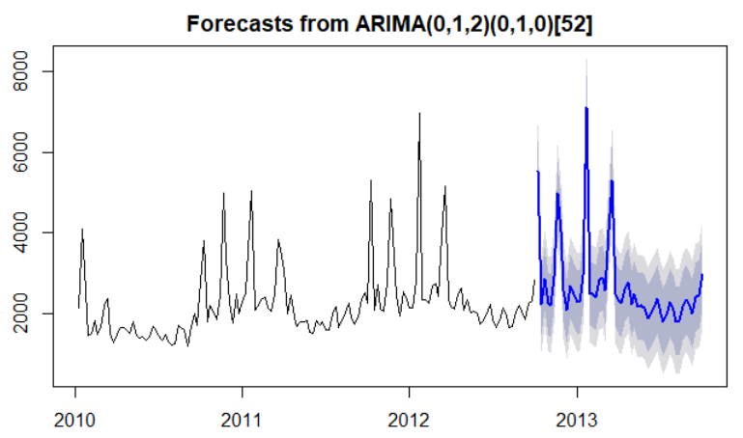
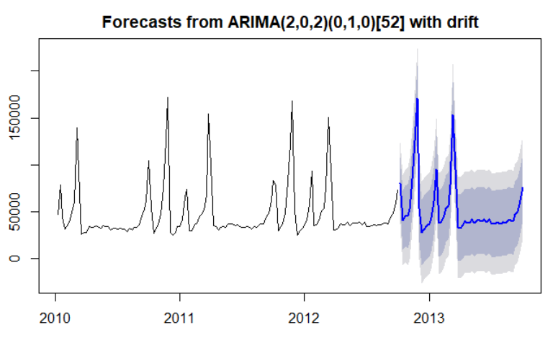
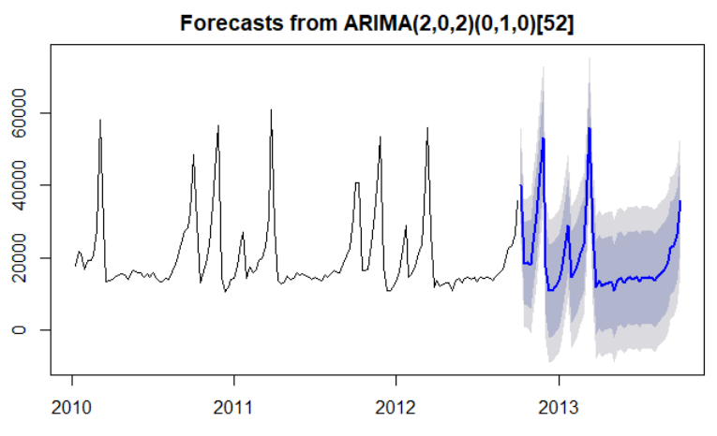

Forecasting with auto arima
Medium
High
Low

Slide 11
Evaluating models
Seasonal trend decomposition with loess
Error, trend, seasonality
h=39, s.window=13
stl, ets
auto-arima
Auto-regressive automated moving average
p, q, d
Mean Absolute Error
High 6323
Medium 2420
Low 236
stl, naive
regression
Seasonal trend decomposition with loess
Value of last observation
Time series regression
Variables such as CPI, Unemployment, Fuel Price did contribute positive to model

Slide 12
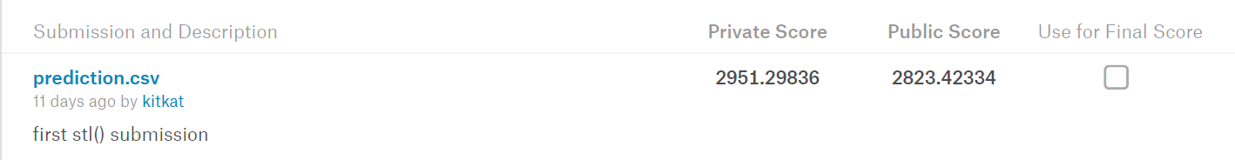
Kaggle competition results
691 competitors
Roughly top 15%

Slide 13



further investigations & Recommendations
Separate high, medium , low stores & departments
stl, ets model
Overall company, but not one size fits all
Geographic area
Clear seasonal trend
Easier to change model in code

Slide 14




lessons learned
Functional programming
=
Awesome!
Memory Issues? Think small
SQL
Big picture sacrifice

Slide 15
AKNOWLEDGEMENTS
Insight-driven
creative
Dr. Mike Busch
Val Bardash
Easy to calculate
pricing
Christy Pearson

Slide 16


Git hub & blog
https://github.com/yekbar/WalmartSalesForecasting_Kaggle
https://somanyvariables.wordpress.com/

Slide 17
References
Hyndman, R., and Anthanasopoulos, G. (2016). Otexts - Forecasting: Principles and practice. Retrieved from https://otexts.org/fpp2/stl.html
Kabacoff, R. (2015). R in action, second edition: Data Analysis and Graphics with R. [Online edition, Safari books].

Slide 18
Appendix

Slide 19
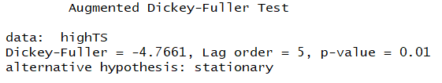
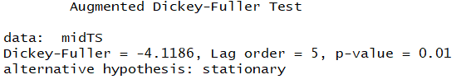
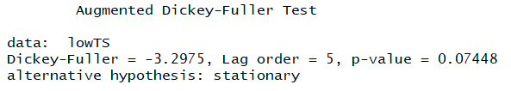
Checking assumptions for ARIMA MODEL
High
Is the Time Series Stationary?
Dickey-Fuller Test
Ho: Time series is not stationary
Ha: Time series is stationary
alpha = 0.05
Medium
Low
Notes:
Make sure to mention what ARIMA is – and how far out I forecasted

Slide 20
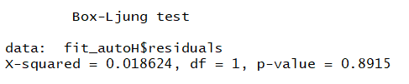
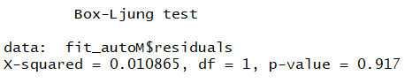
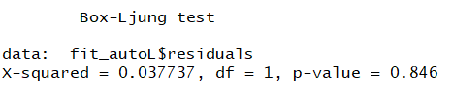
Evaluating model fit :: autocorrelations
High
Are auto correlations zero?
Are residuals normally distributed?
Ljung-Box Test
Ho: Auto correlations are 0, residuals are normally distributed
Ha: Auto correlations are not 0, residuals are not normally distributed
alpha = 0.05
Medium
Low

Slide 21
Evaluating model fit :: AIC
2086
1904
Akaike Information Criterion
Lower = Better
1408
High
Medium
Low

Slide 22
Evaluating model fit :: MAE
7439
2722
Mean Absolute Error
forecasting to median
Lower = Better
287
High
Medium
Low

Slide 23
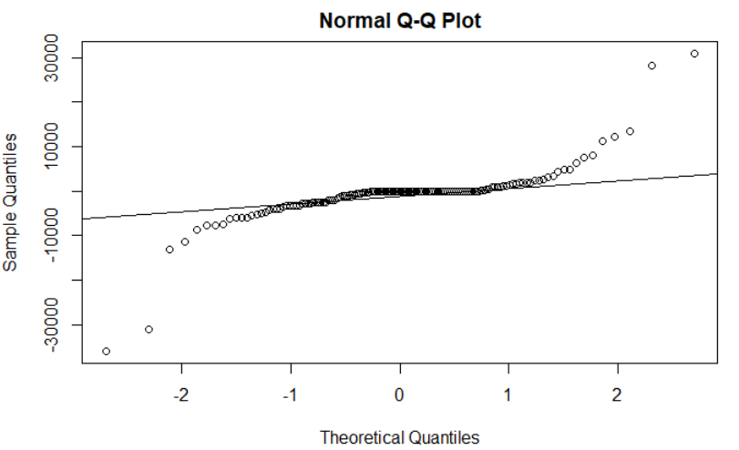
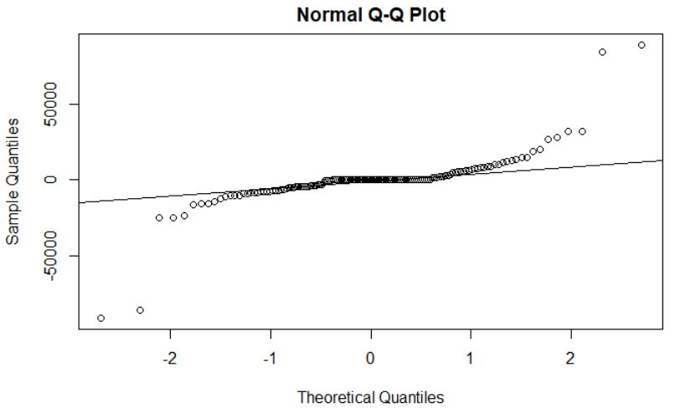
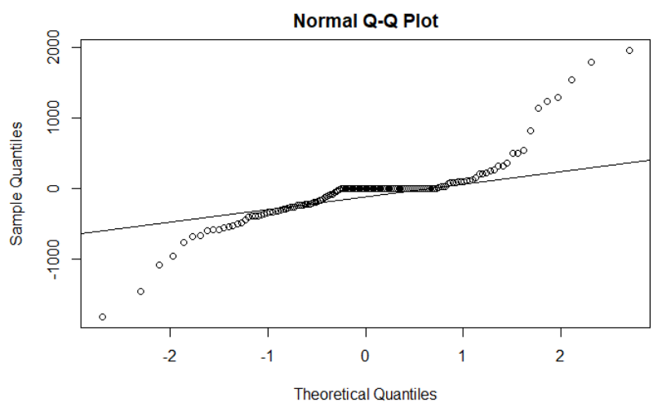
Evaluating model fit :: residual distribution
Low
High
Medium

Slide 24
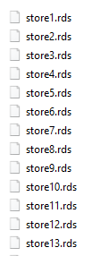
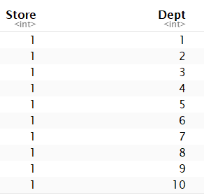
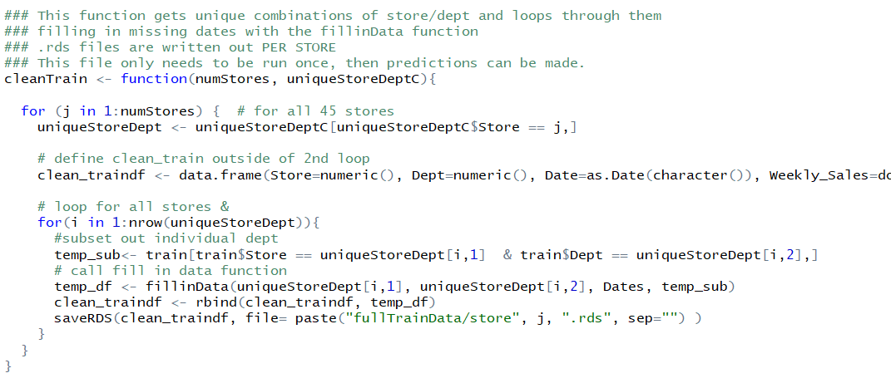
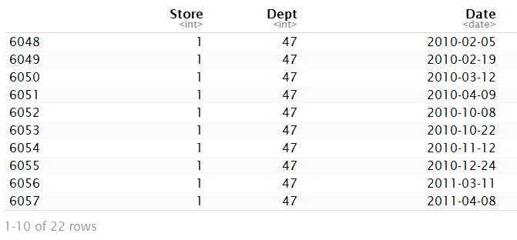
Programming challenges
01
3300 combinations of stores & departments
02
Some store/dept combinations had less than 143 data points
03
Writing functions!
04
Memory issues

